Slide 1
CONSUMER STUDIES

Slide 2
AIM
To equip individuals with the necessary skills to provide financially for themselves and family in the future

Slide 3



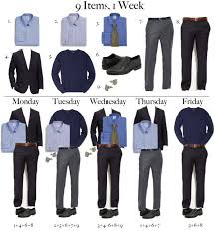

components
Housing and interiors
The consumer
Food and nutrition
clothing

Slide 4
What to look for when buying / renting home
Contractual responsibilities
How to decorate – making the most with what you have
Housing and interiors

Slide 5
Food and nutrition
How to eat balanced meals on a budget
How nutrition can improve lifestyle diseases such as heart disease and diabetes
Practical component – preparing nutritious, cost effective meals

Slide 6
The consumer
How to spend your money wisely
Rights and responsibilities as a consumer
Importance of complaining and how to do so correctly

Slide 7
clothing
How to dress appropriately for different careers and interviews
How to dress to suit your body
Looking at fashion trends and styles

Slide 8
How to use your cooking skills to earn money

Slide 9
practical
Cook once a cycle – school day ends between 3 and 4 depending on practical
Maintenance fee – gr10 – r400 – paid yearly
School apron – r120 (once-off)
Theory of practical workbook – r120 (once-off)
Everything FOR PRACTICAL LESSONS ARE provided

Slide 10
marks
Theory – 75%
Practical – 25%
Promotion mark – written exam 50%, 1 practical exam – 25%, year mark – 25%

