Slide 1
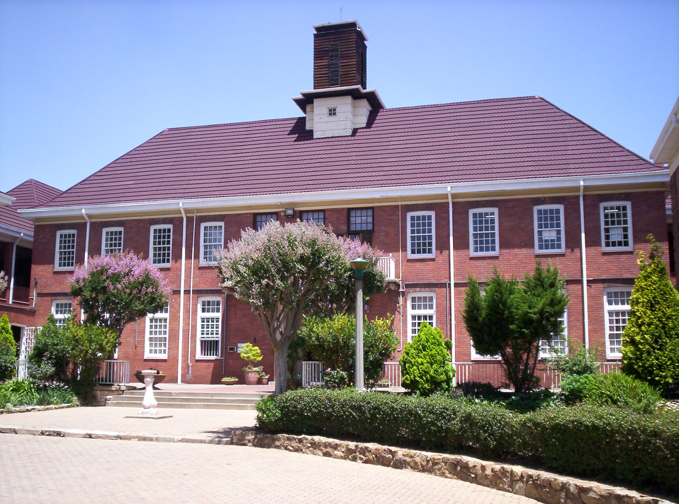
Afrikaans and isiZulu for fet
The value of a second language

Slide 2
Multiple Languages
In the global marketplace it is advantageous to be multilingual as it allows access to a broader range of collaborators and clients.
Having knowledge of languages means that you have the basis for studying related languages.
With the increasing awareness of the value of languages as a tool for preserving culture and identity, there is also an increasing demand for academic research into languages so they can be preserved and also expand to accommodate learning for the development of languages in response to the needs of the 21st century.
Language is the doorway to accessing different and specialised consumers who were previously unknown or poorly serviced.

Slide 3
Willowmoore High School Language choices
Willowmoore High School offers a choice of two different languages at First Additional Language level: Afrikaans and isiZulu.
Afrikaans has been the FAL language since Willowmoore High was founded but isiZulu was added three years ago as an alternative. In 2020 our first grade 12 student will be sitting for her final examinations and we wish her all the best.
Both languages are studied in terms of language and comprehension, creative writing, oral performance and literature analysis.
It is important to state that once a language has been selected at FAL, it is not possible to change to the alternative FAL language.

Slide 4
Which language to choose: Afrikaans or isiZulu?
The simple question is which of these two languages will your child feel the most comfortable studying.
A language needs to be heard, spoken, written and experienced in order for a person to become proficient in it.
It is often forgotten that language is an acquired skill like any other area of study and so it much be practised. It is not enough to study it during class time but rather effort should be made to immerse yourself in the language by engaging with it in the media as it is actively used and spoken.
When a language is chosen, the student needs to be prepared to want to learn it as a potential speaker and not just to acquire enough to “get by”.
It is also important to remember that these subjects are the study of a formal language, not its colloquial form so adjustment will be needed from the everyday usage.

Slide 5
Career Choices
Besides the obvious reality that all careers involve language to function, there are a variety of careers which revolve around language:
Sales
Human Resources Management
Writing, Journalism
Linguistics
International Relations and Diplomacy
Singing and the Dramatic Arts

Slide 6
Careers
Anthropology and Sociology
Community Work
Tourism and Hospitality
Translation and Interpretation
Politics
Historical research and Archaeology
Education and Childhood development
Counselling.

Slide 7
Dankie, Siyabonga
All in all languages open many doors to the world!

