Slide 1
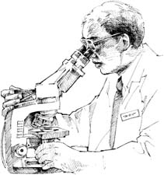
WHY CHOOSE LIFE SCIENCES

Slide 2

IT’S ………
FUN
AWESOME
INTERESTING

Slide 3
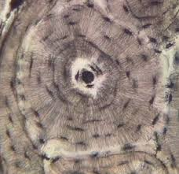

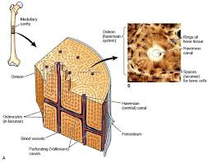
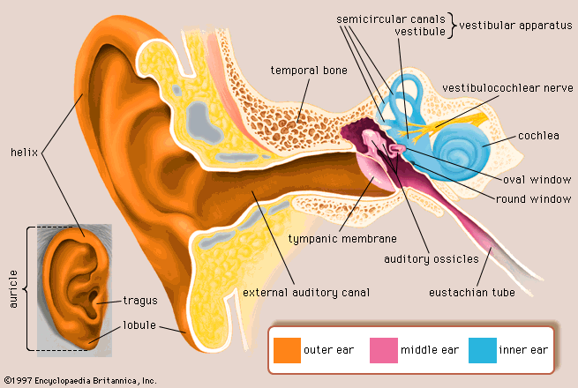
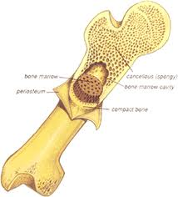
LEARN MORE ABOUT YOUR BODY

Slide 4
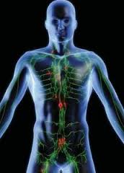


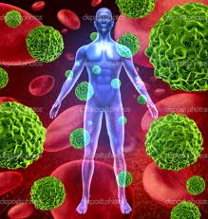
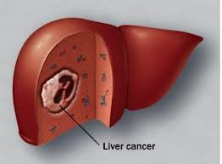
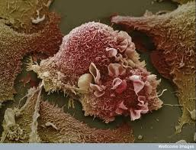

Slide 5

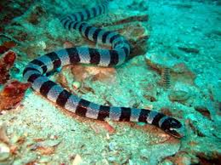
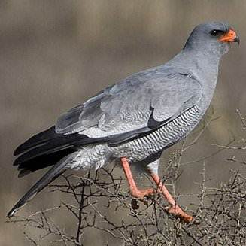

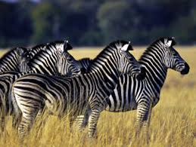
LEARN MORE ABOUT TH E WORLD AND THE LIVING THINGS AROUND YOU

Slide 6



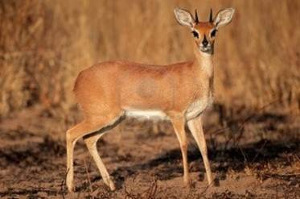

Slide 7





Slide 8
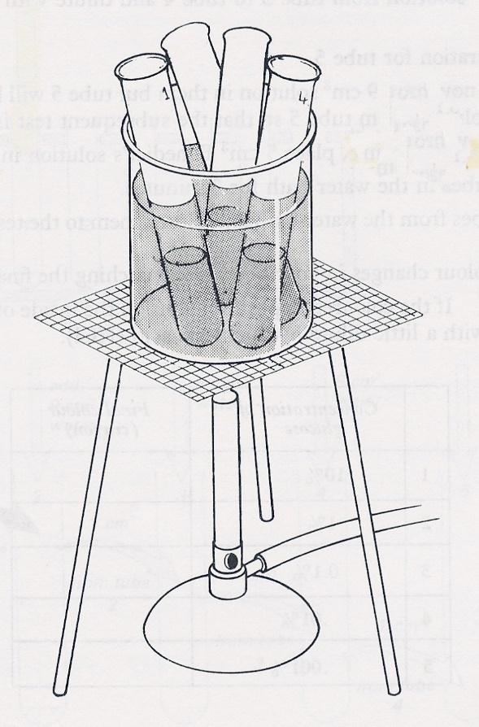
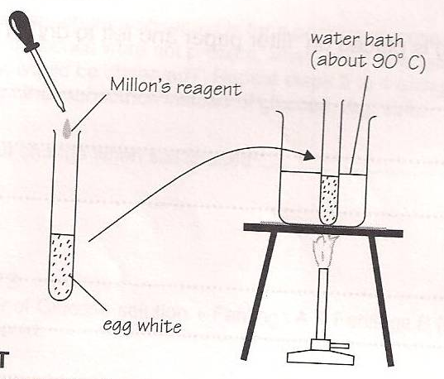
HANDS ON PRACTICAL WORK

Slide 9
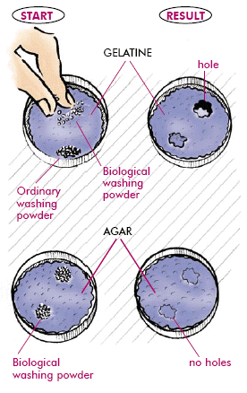


Slide 10
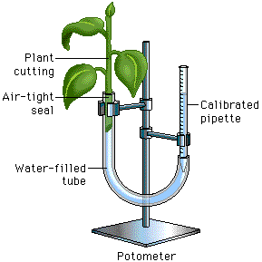


Slide 11
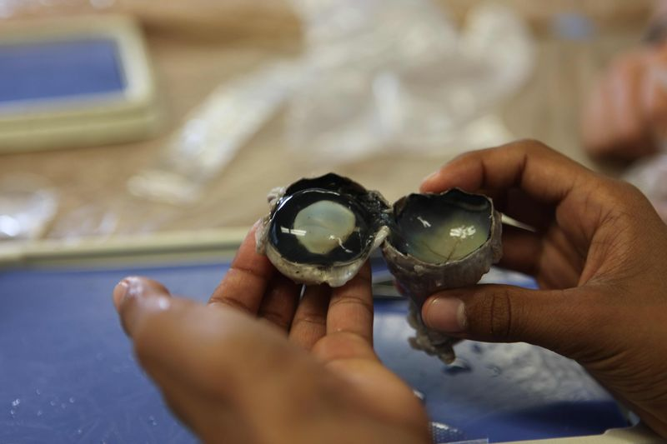
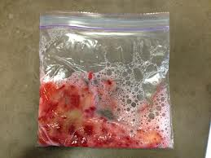
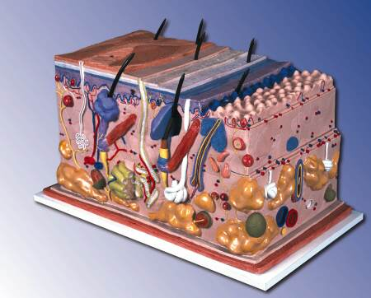

Slide 12
EXCITING
CAREER
CHOICES

Slide 13
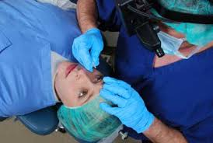
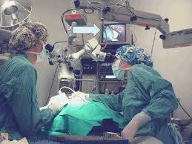

SURGEON OR ANESTHESIOLOGIST

Slide 14



OPTOMETRIST

Slide 15
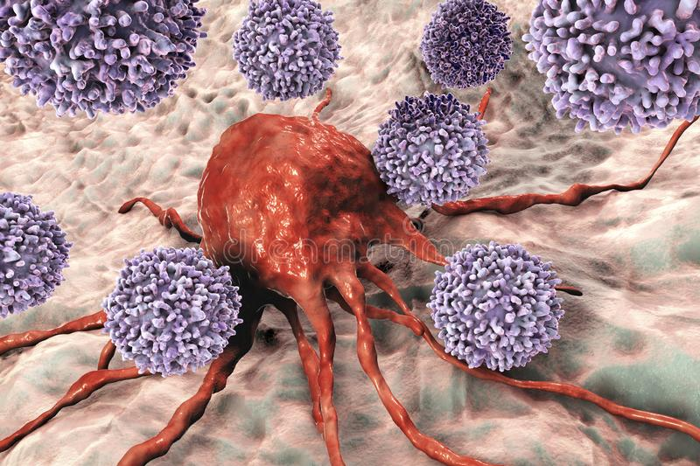
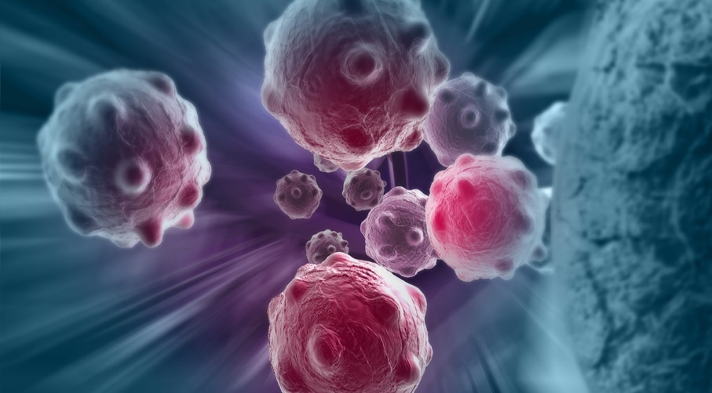
ONCOLOGIST

Slide 16
MORE CAREERS WITH LIFE SCIENCES
MEDICAL PRACTITIONER
NURSING
PAEDIATRICIAN
LABORATORY TESTING
DNA PROFILING
FORENSIC PATHOLOGIST
BIOKINETICS
PSYCHOLOGIST
ARCHAEOLOGIST

Slide 17
MEDICAL DETECTIVE
BOTANIST
ZOOLOGIST
EDUCATOR
SCIENTIST
PATHOLOGIST
VETERINARIAN
PHYSIOTHERAPIST
PHARMACIST

Slide 18
THE LIST IS ENDLESS………

