Slide 1
MECHANICAL TECHNOLOGY
AUTOMOTIVE

Slide 2
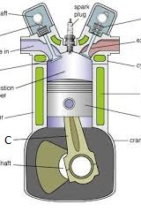
Automotive : is the knowledge of different systems, engine components and functions
Mechanical technology (Automotive) consist of the following.
Theory (9 Chapters)
Practical lessons
Practical tasks ( one per term)
Final task
Test in term 1/3
Exam in term 2
Final exam term 4

Slide 3
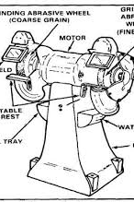
Chapters per year
Safety
Tools Generic/Specific
Engines Generic/Specific
Joining methods
Forces ( calculations related to engine)
Maintenance
Materials
Terminology
Systems and control

Slide 4
Assessments
Practical one per term (50 marks)
Final practical term 4 (100 marks)
Term 2 exam (150 marks)
Final exam 200 marks

Slide 5
Duration of course
Mechanical technology is a 3 year course Grade 10 – 12.
*Each year different topics are covered, and the information of the topics becomes more specific as learners progress to higher grades.
Learner need to complete the course over three years.
All the practical tasks will be assessed by facilitator.
Final exams will be set by DBE.

