Slide 1
Technical department
Subject choices

Slide 2
Why should learners choose technical subjects at willowmoore high school?

Slide 3


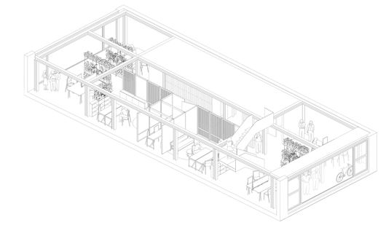
The technical department offers a variety of technical subjects which are a gateway to a professional career in the technical fields
Learners are exposed to introductory key skills and knowledge, which then gives them an advantage, if they aspire to follow a technical career, post matric.

Slide 4
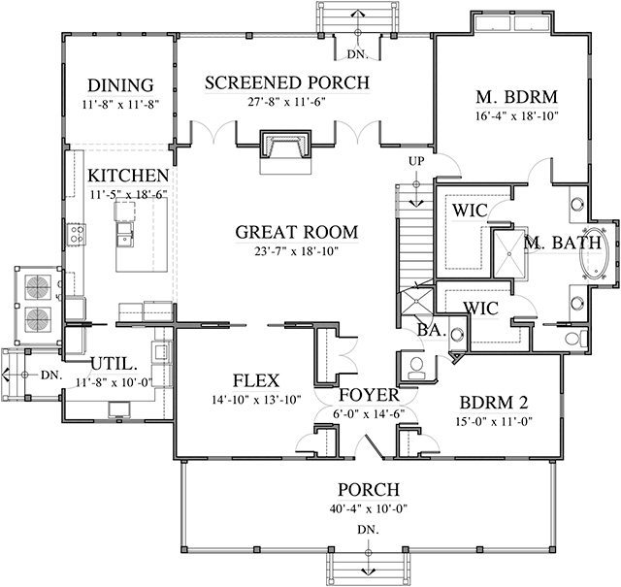
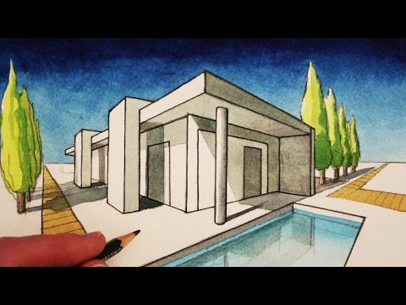
ENGINEERING GRAPHICS AND DESIGN
Engineering Graphics and Design is a communication and management tool that links those who design and plan with those who produce the artifacts and systems. It is used in the design phase to record and develop ideas, and in the manufacturing phase to guide those who do the manufacturing.

Slide 5
PURPOSE OF SUBJECT
Engineering Graphics and Design will contribute towards your technological literacy by giving you opportunities to:
Appreciate the interaction between people’s values and attitudes, society, the environment, human rights and technology.
Apply the design process to solve Civil, Electrical and Mechanical problems analytically and graphically.
Understand the concepts and knowledge used in Engineering Graphics and Design, and use them responsibly and purposefully in the context of Civil, Electrical and Mechanical Technologies.
Develop and apply specific skills related to Engineering Graphics and Design

Slide 6
CAREER OPPORTUNITES
EGD will equip you to explore more careers than you may expect! It will primarily equip you to become a designer or engineer but interior designers, landscape designers, furniture designers, draughters, architects, inventors, people in the construction industry, surveyors and even EGD educators use the skills that you will learn in this subject.
To become a technician, technologist or engineer you must start with a Further Education and Training Certificate (FETC). This is the school-leaving certificate at the end of grade 12. The school subject, Engineering Graphics and Design (EGD) is a recommended subject, along with Mathematics, Science and Languages. This is because EGD equips you to communicate effectively, both reading and producing drawings. EGD will also assist you to solve problems as you engage in the design process.
Career Options:
Architecture • Plan drawing • Graphic design • Electrical draughtsperson • Draughtsperson • Draughtsman • Designing (furniture, Automobiles, Aeronautics)

Slide 7

EDUCATORS
MR MPIYAKHE
MR SINGH

Slide 8
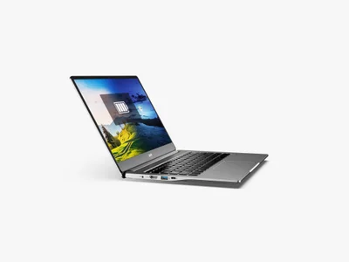

INFORMATION TECHNOLOGY (IT)
Information Technology is the study of the various interrelated physical and non-physical technologies used for the capturing of data, the processing of data into useful information and the management, presentation and dissemination of data. Information Technology studies the activities that deal with the solution of problems through logical and computational thinking. It includes the physical and non-physical components for the electronic transmission, access, and manipulation of data and information.

Slide 9

Information Technology specifically forms the underpinning basis for studies in computer science, information systems, engineering and the business sciences. In general, it lays a foundation for programmes such as the following offered in Higher Education and Training:
Bio-informatics
Business information systems
Computer engineering
Computer science
Computer science education
Financial information systems
Geographical information systems
Informatics
Information systems
Information technology

Slide 10

It provides computing skills across the entire spectrum of careers and opens pathways for careers such as:
Computer or software architect
Data communication and network specialist
Financial and actuarial specialist
Hardware and software support technician
Information systems and technology manager
Information technology educator or trainer
Information technology sales executive
Programmer
Systems developer
Telecommunications engineer.

Slide 11

Educators
MRS SANDERS

Slide 12
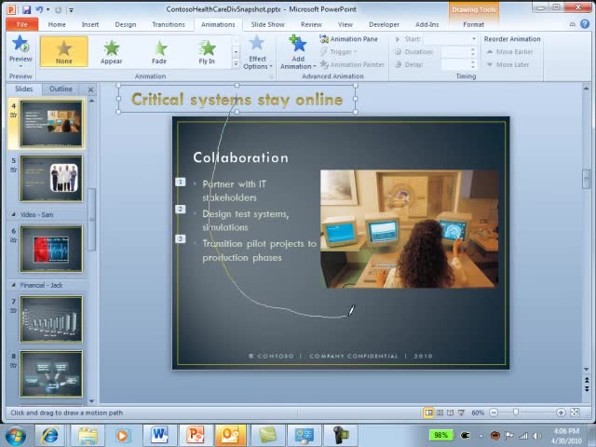

COMPUTER APPLICATIONS TECHNOLOGY
Computer Applications Technology is the study of the integrated components of a computer system (hardware and software) and the practical techniques for their efficient use and application to solve everyday problems. The solutions to problems are designed, managed and processed via end-user applications and communicated using appropriate information and communication technologies (ICTs). ICTs are the combination of networks, hardware and software as well as the means of communication, collaboration and engagement that enable the processing, management and exchange of data, information and knowledge.
Computer Applications Technology aims at developing computing skills in the following packages: Word, Excel, Access, Explorer, Outlook and Power Point and basic HTML (webpage). Learners will be able to use the Internet, and understand the role that it plays, find relevant information, process it, make decisions, and learn how to use ICTs responsibly. A fairly high level of competency is expected.

Slide 13
In Computer Applications Technology a learner will:
Use end-user software applications proficiently to produce solutions to problems within a defined scenario
Understand the concepts of ICTs with regard to the technologies that make up a computing system
Understand the various technologies, standards and protocols involved in the electronic transmission of data via a computer-based network
Use the Internet and the WWW and understand the role that the Internet plays as part of the global information superhighway
Find authentic and relevant information, process the information to draw conclusions, make decisions and communicate the findings in appropriate presentation media
Recognise the legal, ethical, environmental, social, security and health issues related to the use of ICTs and learn how to use ICTs responsibly.
Should I take this subject?
If you enjoy working with computers and its many applications, then CAT is a good subject to take. The great advantage of this subject is that it provides skills that can be applied immediately in the classroom and the workplace. Like all matric subjects, CAT will require consistent application and hard work. CAT is now regarded as a designated subject: this means that it will be used for determining university acceptance to university.

Slide 14
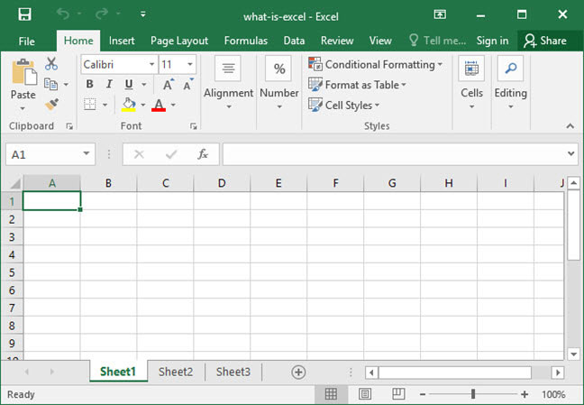
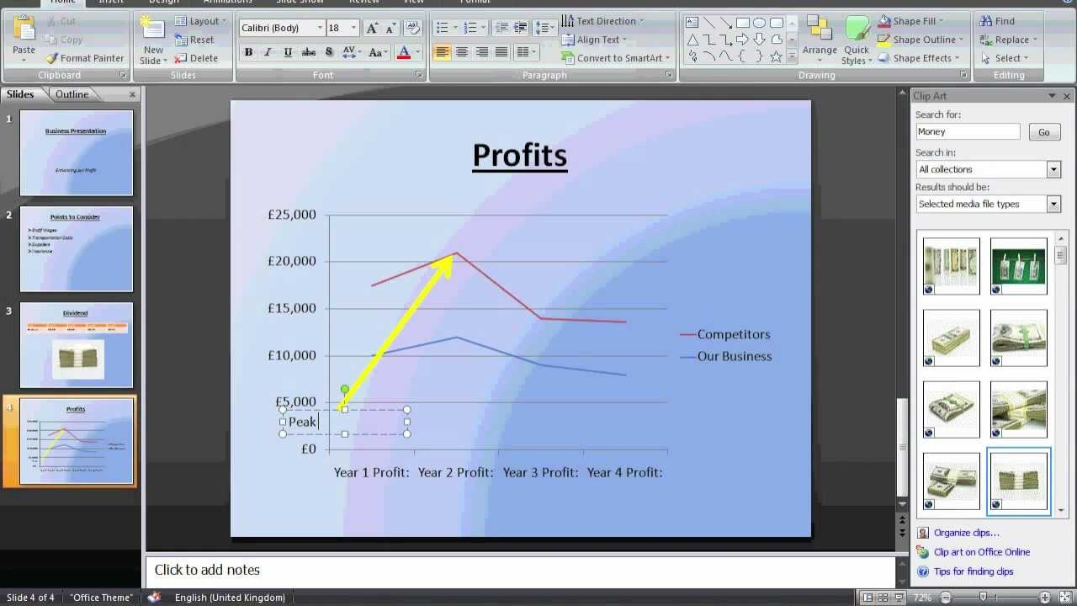
Careers
Although CAT is not a compulsory subject for any particular field of study, this subject does provide you with a range of basic skills useful in the field of Information Technology should you wish to study in this field further one day. The ability to use computer applications efficiently is a distinct advantage in many fields. Students also complete the ICDL (International Computers Drivers Licence) course during Grade 10 and 11. Not only does this give them an excellent platform from which to do Grade 12 CAT, but is an asset on their CV.

Slide 15
EDUCATORS
MR COOK

Slide 16
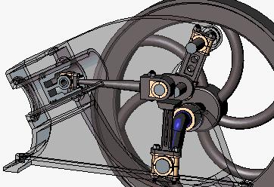
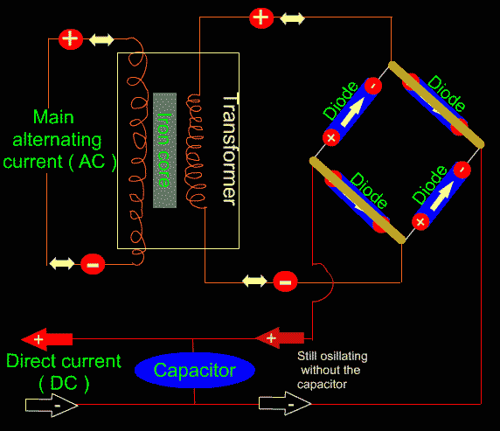
MECHANICAL TECHNOLOGY
Mechanical Technology focuses on concepts and principles in the mechanical (motor, mining, shipping, rail, powergeneration, etc.) environment and on technological processes. It embraces practical skills and the application of scientific principles. This subject aims to create and improve the engineering and manufacturing environment to enhance the quality of life of the individual and society and ensure the sustainable use of the natural environment.

Slide 17
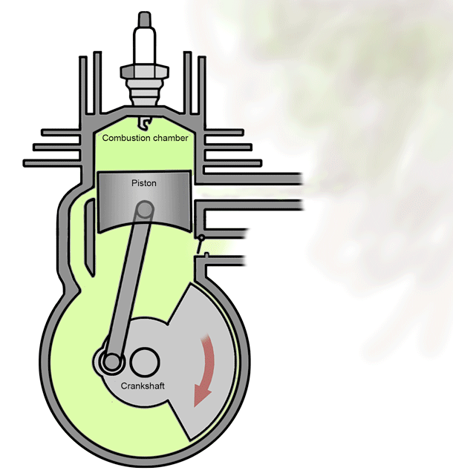
The learner in Mechanical Technology needs to be interested in any form of mechanical entities. It can be cars, planes, trains, welding, maintenance, etc.
In order to be successful the learner also has to enroll preferably in Mathematics, Physical Science and Engineering Graphics and Design, as they all form part of the technical studying field.
Mechanical Technology in essence is applied science, as the field of work includes trigonometry, Newton’s laws and chemical equations when dealing with certain welding techniques, fuel combustion, fuel injection, cooling systems, etc.

Slide 18
The main topics in Mechanical Technology are:
Safety - Occupational Health and Safety (OHS) Act;
Tools and equipment;
materials - ferrous and non-ferrous materials and alloys and the iron-carbon equilibrium diagram;
Terminology - manufacturing processes with reference to lathes (diameter turning, taper cutting, screw cutting)and milling machines (cutting methods, dividing head, centring of cutter);
Joining methods - permanent (welding) and semi-permanent (bolts, nuts and rivets) joints;
Forces - forces, moments, Young’s modulus, stress and strain; maintenance; systems and control:
- Mechanical - gears, belts, pulleys, power transmission, chains, clutches, cams, levers, etc;
- Hydraulics - pistons, valves, Pascal’s law;
- Pneumatics;
- Electrical wiring - starting and charging circuits; and
- Electronic applications - anti-lock braking system (ABS), fuel injection, air bag control, etc.;

Slide 19
Career opportunities in Mechanical Technology
Apprenticeship as a motor mechanic, fitter and turner, welder, boiler maker, tractor mechanic, etc.
Engineering studies in the fields of aviation, air-conditioning, motor cars, engines, ship building, power systems, electrical power stations, etc.
Studies at Universities of Technology in various mechanical streams
Entering the world of work as an entrepreneur in various fields such as precision machining, programming of lathes and milling machines, fitment of accessories to cars and trucks to enhance performance, maintenance of many different mechanical installations
Research and development of new and current entities in the mechanical field of work
Mechanical Technology does not have the distinction of being a grade 12 exemption subject; it has the advantage of giving the learner the background of what is expected from them when enrolling in any mechanical study opportunities.

Slide 20
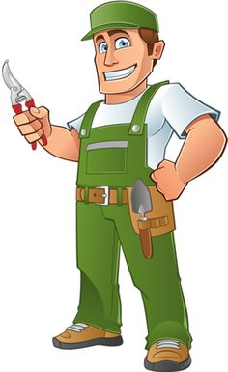
EDUCATORS
MR LAMPRECHT

Slide 21
references
https://www.abassessments.co.za/information-on-grade-10-subjects
https://www.education.gov.za/Portals/0/CD/National%20Curriculum%20Statements%20and%20Vocational/CAPS%20FET%20_%20MECHANICAL%20TECHNOLOGY%20_%20GR%2010-12%20_%20WEB_36E9.pdf?ver=2015-01-27-154115-810

